Slide 1
Data Visualization Part 1

Slide 2
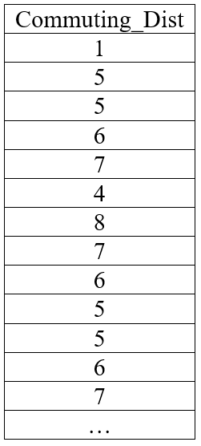
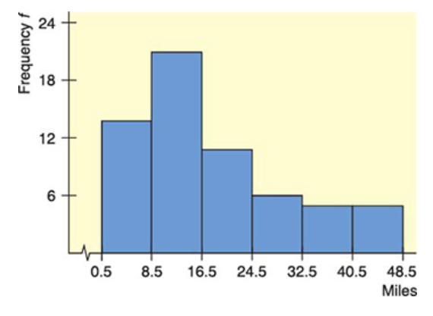
Histograms & Density

Slide 3
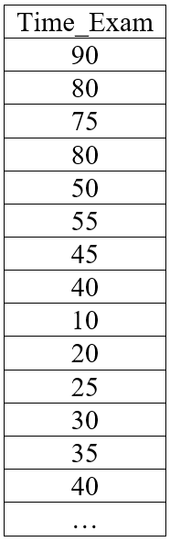
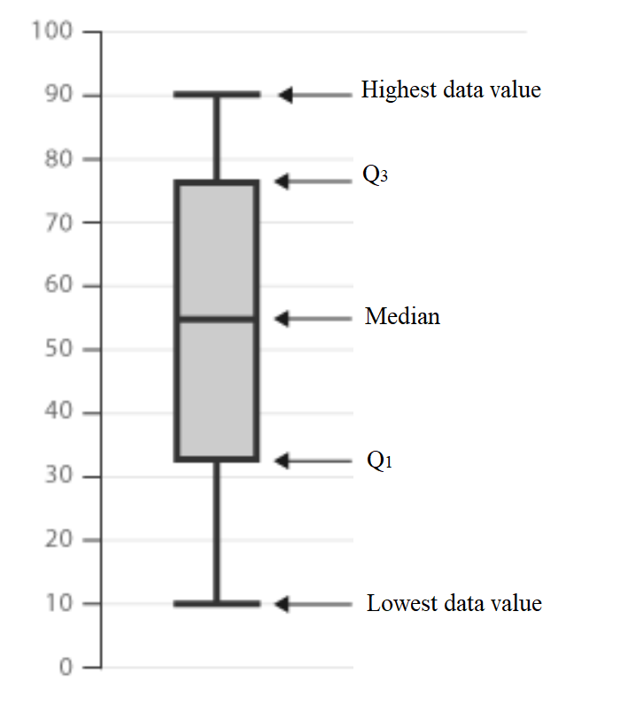
Boxplots

Slide 4
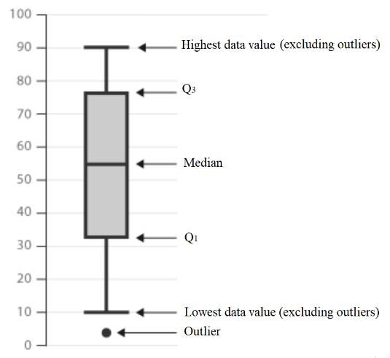
Other ways of representing boxplots:

Slide 5
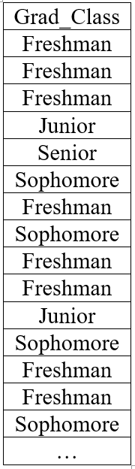
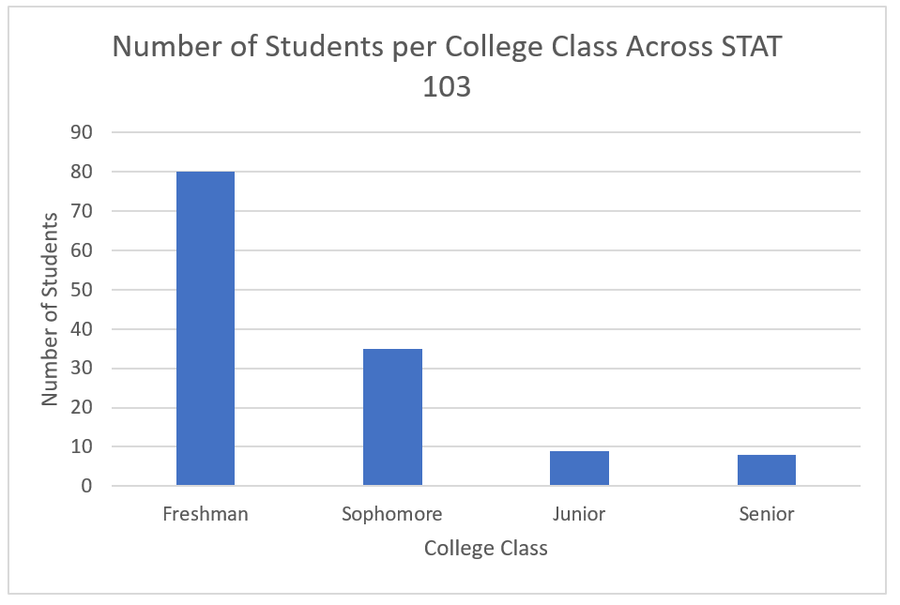
Bar Graphs

Slide 6
ggplot() Function
Data: The dataset you're working with.
Aesthetics Mapping (aes): How data variables map to plot aesthetics like position, color, shape, etc.
x = variable1
y = variable2
color = variable3
fill = variable4
shape = variable5

Slide 7
Geometric Objects (geom): The visual elements to represent the data (points, lines, bars, etc.).
geom_histogram()
geom_density()
geom_boxplot()
geom_line()
geom_bar()
geom_point()

Slide 8
Facets (facet_wrap or facet_grid): Splitting data into subplots based on a variable.
facet_wrap(~ Variable1)
facet_grid(Variable1 ~ Variable2)

Slide 9
Theme: Controlling the overall appearance of the plot.
theme_gray()
theme_bw()
theme_minimal()
theme_void()

Slide 10
Add ons
coord_flip()
geom_smooth(method = "lm", se = FALSE)
geom_smooth(method = "loess", se = TRUE)
scale_fill_manual(values = c("red", "green", "blue"))
scale_color_manual(values = c("red", "green", "blue"))
labs()

Slide 11
ggplot() Function
Command Illustration
Plot_Name <- name_daframe %>%
ggplot(aes(x = column_name)) +
geom_OBJECT()+
facet()+
theme()

Slide 12
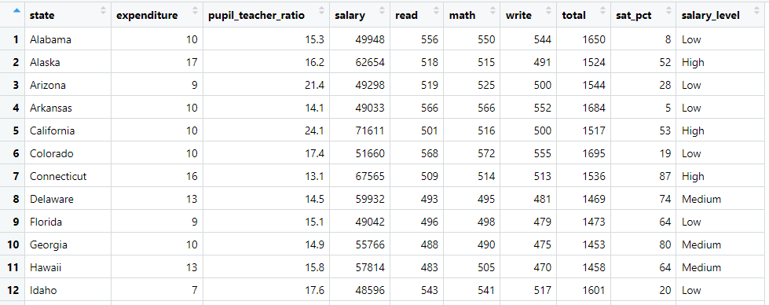
Data

Slide 13
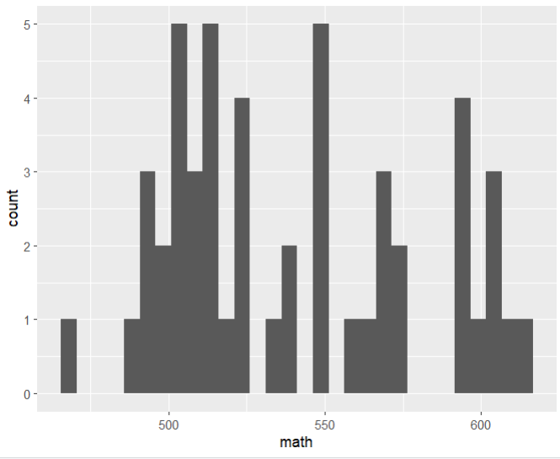
Histograms
Figure 1: Create a Histogram on the Average Math SAT Score.
fig_1 <- SAT_2010 %>%
ggplot(aes(x = math)) +
geom_histogram()
fig_1

Slide 14
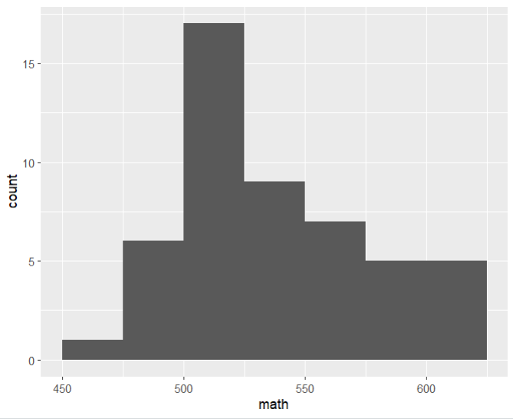
Figure 2: Create a Histogram on the Average Math SAT Score, but change the break points to start from 450, end in 625, and increase by 25
fig_2 <- SAT_2010 %>%
ggplot(aes(x = math)) +
geom_histogram(breaks = c(450,475,500,525,550,575,600,625))
fig_2

Slide 15
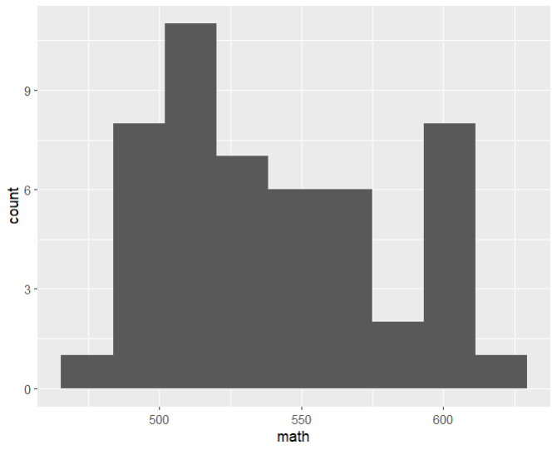
Figure 3: Create a Histogram on the Average Math SAT Score, but choose the bins to be 9.
fig_3 <- SAT_2010 %>%
ggplot(aes(x = math)) +
geom_histogram(bins = 9)
fig_3

Slide 16
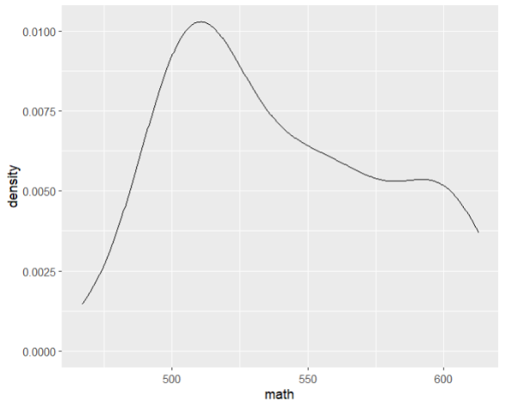
Density Plots
Figure 4: Create a density plot on the Average Math SAT Score
fig_4 <- SAT_2010 %>%
ggplot(aes(x = math)) +
geom_density()
fig_4

Slide 17
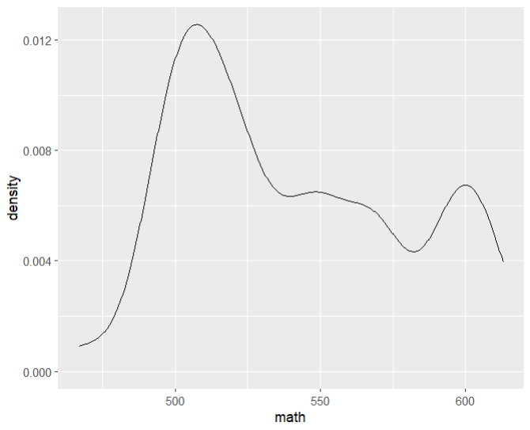
Figure 5: Create a density plot on the Average Math SAT Score. Change the bandwith to 10.
Note: Changing the bandwidth to a smaller number makes it more jagged.
fig_5 <- SAT_2010 %>%
ggplot(aes(x = math)) +
geom_density(bw = 10)
fig_5

Slide 18
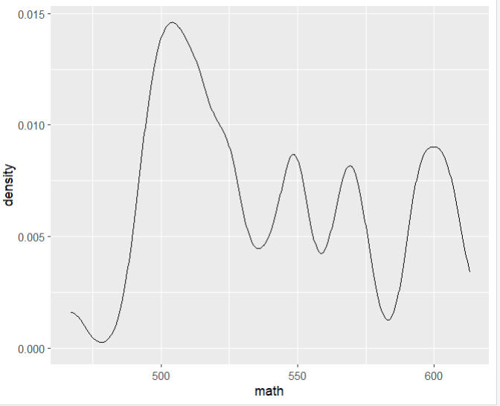
Figure 6: Create a density plot on the Average Math SAT Score. Change the bandwith to 10.
fig_6 <- SAT_2010 %>%
ggplot(aes(x = math)) +
geom_density(bw = 5)
fig_6

Slide 19
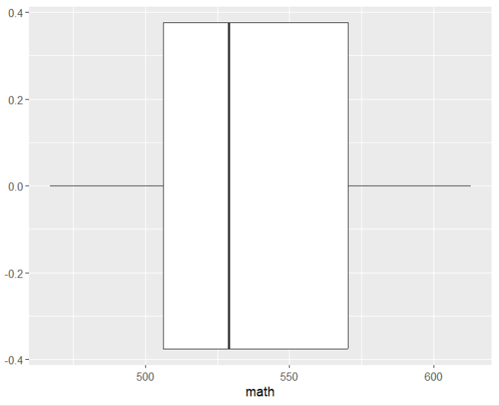
Boxplots
Figure 7: Create a box plot on the Average Math SAT Score.
fig_7 <- SAT_2010 %>%
ggplot(aes(x = math)) +
geom_boxplot()
fig_7

Slide 20
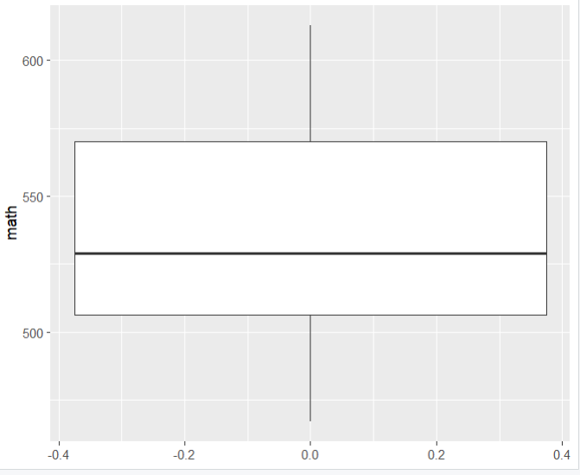
Figure 8: Create a box plot on the Average Math SAT Score. Make the boxplot vertical.
fig_8 <- SAT_2010 %>%
ggplot(aes(x = math)) +
geom_boxplot() +
coord_flip()
fig_8

Slide 21
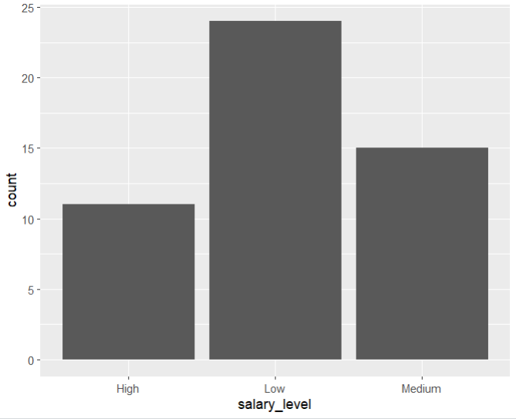
Bar Plots
Figure 9: Create a bar graph on the Salary Level (the new variable you created).
fig_9 <- SAT_2010 %>%
ggplot(aes(x = salary_level)) +
geom_bar()
fig_9

Slide 22
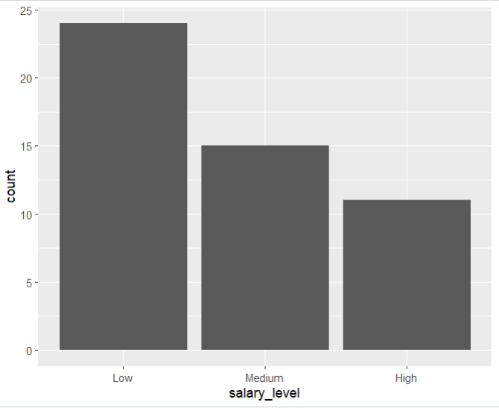
Figure 10: Create a bar graph on the Salary Level (the new variable you created). Have the category "Low" appear first, then "Medium", then "High".
fig_10 <- SAT_2010 %>%
mutate(salary_level = factor(salary_level, levels = c("Low", "Medium", "High"))) %>%
ggplot(aes(x = salary_level)) +
geom_bar()
fig_10

